Slide 1
Management of Neonates With Suspected or Proven Early-Onset Bacterial Sepsis
Richard A. Polin and the COMMITTEE ON FETUS AND NEWBORN
Pediatrics 2012;129;1006; originally published online April 30, 2012

Slide 2
Content
Abstract
Pathogenesis and Epidemiology
Diagnostic testing
Treatment of infants with suspected early-onset
Prevention strategies for early-onset sepsis
Clinical challenges
Conclusions

Slide 3
Abstract
Early-onset sepsis remains one of the most common causes of neonatal morbidity and mortality in the preterm population.
Diagnostic tests for neonatal sepsis have a poor positive predictive accuracy
Recent data suggest an association between prolonged empirical treatment of preterm infants (≥5 days) with broad-spectrum antibiotics and higher risks of late onset sepsis, necrotizing enterocolitis, and mortality
The purpose of this clinical report is to provide apractical and, when possible, evidence-based approach to the managementof infants with suspected or proven early- onset sepsis

Slide 4
What are challenges for clinicians?
Identifying neonates with a high likelihood of sepsispromptly and initiating antimicrobial therapy
Distinguishing “highrisk” healthy-appearing infants or infants with clinical signs who do not require treatment
Discontinuing antimicrobial therapy once sepsis is deemed unlikely

Slide 5
Pathogenesis and Epidemiology
Chorioamnionitis is a major risk factor for neonatal sepsis
Diagnosis: based on maternal fever >38°C and at least two of the following criteria:
  maternal leukocytosis (>15 000 cells/mm3)
  maternal tachycardia (>100 beats/minute)
  fetal tachycardia (>160 beats/minute)
  uterine tenderness
  and/or foul odor of the amniotic fluid

Slide 6
Pathogenesis and Epidemiology
The major risk factors for chorioamnionitis:
  low parity
  spontaneous labor
  longer length of labor and membrane rupture
  multiple digital vaginal examinations (especially with ruptured membranes)
  meconium-stained amniotic fluid
  internal fetal or uterine monitoring
  and presence of genital tract microorganisms

Slide 7
Pathogenesis and Epidemiology
The rate of microbial invasion of the amniotic cavity:
  Term gestation, intact membranes: <1%
  Preterm labor, intact membranes: 32%
  PPROM: 75%
Preterm birth/low birth weight is the risk factor most closely associated with early-onset sepsis
Many of the pathogens recovered from amniotic fluid in women with preterm labor or PPROM (eg, Ureaplasma species or Mycoplasma species) do not cause early-onset sepsis.
However, both Ureaplasma and Mycoplasma organisms can be recovered from the bloodstream of infants whose birth weight is <1500 g

Slide 8
Diagnostic testing
Blood Culture:
  Require for all neonates with suspected sepsis
  1.0 mL of blood should be the minimum volume drawn
  A study by Connell et al indicated that blood cultures with an adequate volume were twice as likely to yield a positive result
  A blood culture through an umbilical artery catheter is an acceptable alternative to a culture drawn from a peripheral vein

Slide 9
Diagnostic testing
Lumbar Puncture
  In bacteremic infants, the incidence of meningitis may be as high as 23%
  Blood cultures can be negative in up to 38% of infants with meningitis
The lumbar puncture should be performed in infants with:
  positive blood culture
  clinical course or laboratory data strongly suggest bacterial sepsis
  worsen with antimicrobial therapy

Slide 10
Diagnostic testing
Cerebrospinal fluid (CSF)
  In a study by Garges et al, the median number of white blood cells in infants who had bacterial meningitis: >34 weeks’ gestation was 477/mm³ , <34 weeks’ gestation was 110/mm³
  Infants with meningitis attributable to Gram-negative pathogens typically have higher CSF white blood cell counts than do infants with meningitis attributable to Grampositive pathogens
  Protein concentrations are higher and glucose concentrations are lower in term than in preterm infants with meningitis

Slide 11
Diagnostic testing
Peripheral White Blood Cell Count and Differential Count
  Total white blood cell counts have little value in the diagnosis of early-onset sepsis and have a poor positive predictive accuracy
  Neutrophil indices have proven most useful for excluding infants without infection rather than identifying infected neonates
  Neutropenia may be a better marker and has better specificity than an elevated neutrophil count
  In late preterm and term infants, the definition for neutropenia most commonly used is that suggested by Manroe et al (<1800/mm3 at birth and <7800/mm3 at 12–14 hours of age)

Slide 12
Diagnostic testing
Schmutz et al reinvestigated in 30 254 infants born at 23 to 42 weeks’ gestation
Peak values occurred at 6 to 8 hours after birth
The lower limits of normal for neutrophil values:
The I/T ratio has the best sensitivity of any of the neutrophil indices
The I/T ratio is <0.22 in 96% of healthy preterm infants born at <32 weeks’ gestational age
A single determination of the I/T ratio has a poor positive predictive accuracy (approximately 25%) but a very high negative predictive accuracy (99%)
 | At birth (/mm³) | 6-8h after birth (/mm³)
> 36 weeks | 3500 | 7500
28 – 36 weeks | 1000 | 3500
< 28 weeks | 500 | 1500

Slide 13
Diagnostic testing
Acute-Phase Reactants
  CRP increases within 6 to 8 hours of an infectious episode in neonates and peaks at 24 hours
  The sensitivity is low at birth
  Benitz et al have demonstrated that excluding a value at birth, 2 normal CRP determinations (8–24 hours after birth and 24 hours later) have a negative predictive accuracy of 99.7% and a negative likelihood ratio of 0.15 for proven neonatal sepsis
  If CRP determinations remain persistently normal, it is strong evidence that bacterial sepsis is unlikely, and antimicrobial agents can be safely discontinued

Slide 14
Diagnostic testing
  Procalcitonin increase within 2 hours of an infectious episode, peak at 12 hours, and normalize within 2 to 3 days in healthy adult volunteers
  A physiologic increase in procalcitonin occurs within the first 24 hours of birth, and an increase in serum can occur with noninfectious conditions (eg, respiratory distress syndrome)
  Procalcitonin has a modestly better sensitivity than does CRP but is less specific

Slide 15
Treatment of infants with suspected early-onset
A combination of ampicillin and an aminoglycoside (usually gentamicin) is generally used as initial therapy, and this combination of antimicrobial agents also has synergistic activity against GBS and Listeria monocytogenes
Third-generation cephalosporins (eg, cefotaxime) represent a reasonable alternative to an aminoglycoside
Several studies have reported rapid development of resistance cefotaxime, and prolonged use of third-generation cephalosporins risk factor for invasive candidiasis

Slide 16
Treatment of infants with suspected early-onset
Bacteremia without an identifiable focus of infection is generally treated for 10 days
Gramnegative meningitis is treated for minimum of 21 days or 14 days after obtaining a negative culture
Uncomplicated meningitis attributable to GBS is treated for a minimum of 14 days
In a retrospective study by Cordero and Ayers, the average duration of treatment in 695 infants (<1000 g) with negative blood cultures was 5 ± 3 days
Cotten et al have suggested an association with prolonged administration of antimicrobial agents (>5 days) in infants with suspected early-onset sepsis (and negative blood cultures) with death and necrotizing enterocolitis

Slide 17
Prevention strategies for early-onset sepsis
The only intervention is maternal treatment with intrapartum intravenous antimicrobial agents for the prevention of GBS infections
Penicillin (the preferred agent), ampicillin, or cefazolin given for ≥4 hours before delivery
Intrapartum antimicrobial agents are indicated for the following situations:
  Positive antenatal cultures or molecular test at admission for GBS (except for women who have a cesarean delivery without labor or membrane rupture)
  Unknown maternal colonization status with gestation <37 weeks, rupture of membranes >18 hours, or >38°C
  GBS bacteriuria during the current pregnancy
  Previous infant with invasive GBS disease

Slide 18
Clinical challenges
Challenge 1: Identifying Neonates With Clinical Signs of Sepsis With a “High Likelihood” of Early-Onset Sepsis Who Requir Antimicrobial Agents Soon After Birth
Most infants with early-onset sepsis exhibit abnormal signs in the first 24 hours of life
Approximately 1% of infants will appear healthy at birth and then develop signs of infection after a variable time period
Every critically ill infant should be evaluated and receive empirical broad-spectrum antimicrobial therapy after cultures, even when there are no obvious risk factors for sepsis.

Slide 19
Clinical challenges
Challenge 2: Identifying Healthy-Appearing Neonates With a “High Likelihood” of Early-Onset Sepsis Who Require Antimicrobial Agents Soon After Birth
The greatest risk of early-onset sepsis occurs in infants born to women with chorioamnionitis who are also colonized with GBS and did not receive intrapartum antimicrobial agents.
Early-onset sepsis does occur in infants who appear healthy at birth

Slide 20
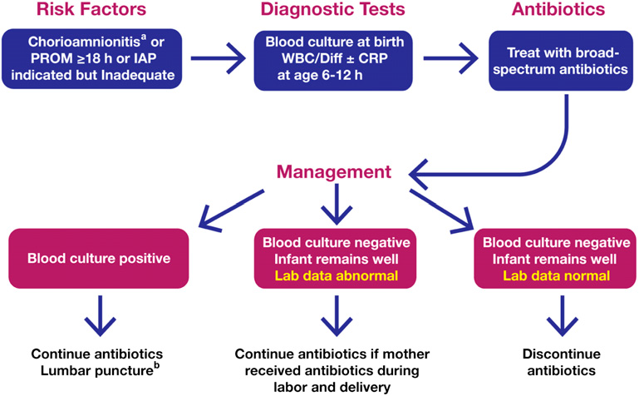
Infants <37 weeks’ gestation

Slide 21
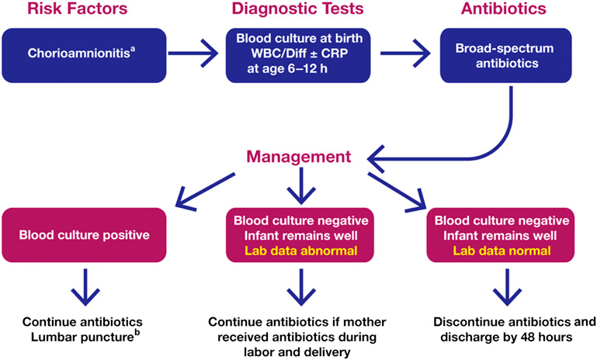
Infants ≥37 weeks’ gestation

Slide 22
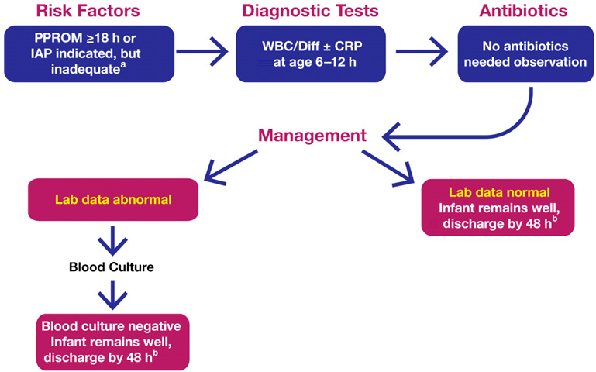
Infants ≥37 weeks’ gestation

Slide 23
Conclusions
Neonatal sepsis is a major cause of morbidity and mortality
Diagnostic tests for early-onset sepsis (other than blood or CSF cultures) are useful for identifying infants with a low probability of sepsis but not at identifying infants likely to be infected.
One milliliter of blood drawn before initiating antimicrobial therapy
Lumbar puncture is not needed in all infants with suspected sepsis
The optimal treatment of infants with suspected early-onset sepsis is broad-spectrum antimicrobial agents
Antimicrobial therapy should be discontinued at 48 hours in clinical situations in which the probability of sepsis is low.

Slide 24

Thank you for your attention

